Slide 1
Stored Procedure with Triggers
Lab # 12

Slide 2
Triggers :
A trigger is a special kind of a store procedure that executes in response to certain action on the table like insertion, deletion or updation of data. It is a database object which is bound to a table and is executed automatically.
Triggers help the database designer ensure certain actions, such as maintaining an audit file, are completed regardless of which program or user makes changes to the data.
The programs are called triggers since an event, such as adding a record to a table, fires their execution.

Slide 3
Types of triggers
SQL Server provides three type of triggers:
Data manipulation language (DML) triggers which are invoked automatically in response to INSERT, UPDATE, and DELETE events against tables.
Data definition language (DDL) triggers which fire in response to CREATE, ALTER, and DROP statements. DDL triggers also fire in response to some system stored procedures that perform DDL-like operations.
Logon triggers which fire in response to LOGON events

Slide 4
Events
The triggers can occur AFTER or INSTEAD OF a DML action.
Triggers are associated with the database DML actions INSERT, UPDATE, and DELETE.
Triggers are defined to run when these actions are executed on a specific table.

Slide 5
Special Database Objects
Triggers use two special database objects, INSERTED and DELETED, to access rows affected by the database actions. Within the scope of a trigger the INSERTED and DELETE objects have the same columns as the trigger’s table.
The INSERTED table contains all the new values; whereas, the DELETED table contains old values. Here is how the tables are used:
INSERT – Use the INSERTED table to determine which rows were added to the table.
DELETE – Use the DELETED table to see which rows were removed from the table.
UPDATE – Use the INSERTED table to inspect the new or updated values and the DELETED table to see the values prior to update.

Slide 6
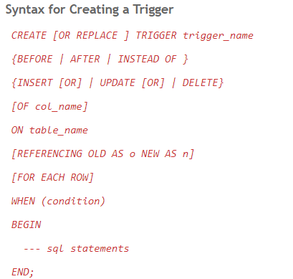
Syntax Of triggers

Slide 7
Common Types ofTriggers
Row Triggers and Statement Triggers
A row trigger is fired each time the table is affected by the triggering statement. For example, if an UPDATE statement updates multiple rows of a table, a row trigger is fired once for each row affected by the UPDATE statement. If a triggering statement affects no rows, a row trigger is not run.
A statement trigger is fired once on behalf of the triggering statement, regardless of the number of rows in the table that the triggering statement affects, even if no rows are affected. For example, if a DELETE statement deletes several rows from a table, a statement-level DELETE trigger is fired only once.

Slide 8
Common Types Of triggers
Triggers on System Events and User Events
System events
Database startup and shutdown
Server error message events
User events
User logon and logoff
DDL statements (CREATE, ALTER, and DROP)
DML statements (INSERT, DELETE, and UPDATE)

Slide 9
After Triggers
This trigger fires after SQL Server completes the execution of the action successfully that fired it.
Example :If you insert record/row in a table then the trigger associated with the insert event on this table will fire only after the row passes all the checks, such as primary key, rules, and constraints. If the record/row insertion fails, SQL Server will not fire the After Trigger.
After triggers are run after a DML action, such as an INSERT statement
You can’t cancel the database action using an AFTER trigger. This is because the action has already completed.
You can’t define AFTER triggers on views.

Slide 10
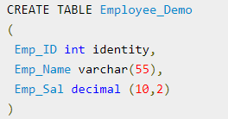
After Triggers Example for insert
Step 1:First create table Employee_Demo

Slide 11
After Triggers Example for insert
Step2:Now Insert records
Insert into Employee_Demo values ('Amit',1000);
Insert into Employee_Demo values ('Mohan',1200);
Insert into Employee_Demo values ('Avin',1100);
Insert into Employee_Demo values ('Manoj',1300);
Insert into Employee_Demo values ('Riyaz',1400);

Slide 12
After Triggers Example for insert
Step 3: Now create table Employee_Demo_Audit for logging/backup purpose of table Employee_Demo
create table Employee_Demo_Audit
(
Emp_ID int,
Emp_Name varchar(55),
Emp_Sal decimal(10,2),
Audit_Action varchar(100),
Audit_Timestamp datetime
)

Slide 13
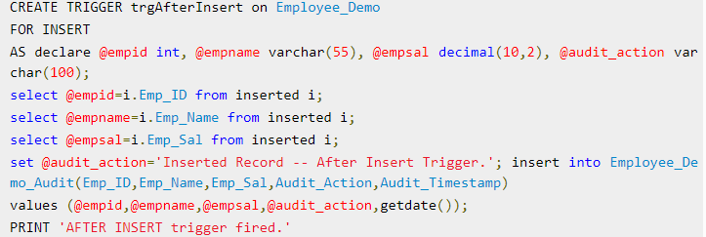
After Triggers Example for insert
Step 4:Create trigger on table Employee_Demo for Insert statement

Slide 14
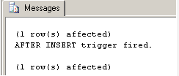
After Triggers Example for insert
Step5: Now try to insert data in Employee_Demo table
insert into Employee_Demo(Emp_Name,Emp_Sal)values ('Shailu',1000);
Output will be

Slide 15
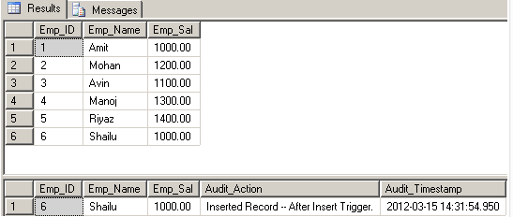
After Triggers Example for insert
Step 6: now select data from both the tables to see trigger action
select * from Employee_Demo
select * from Employee_Demo_Audit
Output:
Trigger have inserted the new record to Employee_Demo_Audit table for insert statement. In this way we can trace a insert activity on a table using trigger.

Slide 16
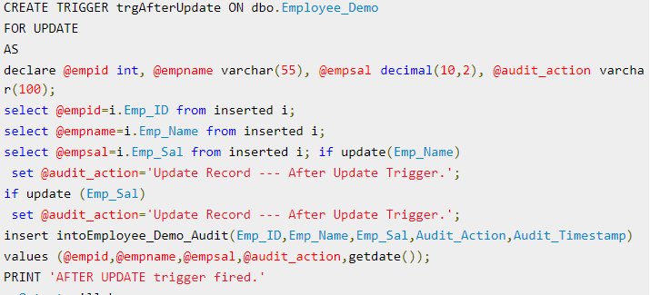

After Triggers Example for update
Create trigger on table Employee_Demo for Update statement

Slide 17
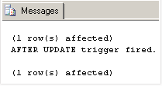
After Triggers Example for update
Now try to upadte data in Employee_Demo table
update Employee_Demo set Emp_Name='Pawan' Where Emp_ID =6;
Output:

Slide 18
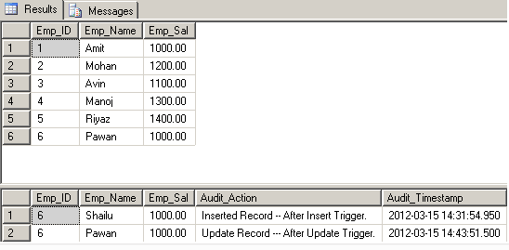
After Triggers Example for update
now select data from both the tables to see trigger action
select * from Employee_Demo
select * from Employee_Demo_Audit
Output:
Trigger have inserted the new record to Employee_Demo_Audit table for update statement. In this way we can trace a update activity on a table using trigger.

Slide 19
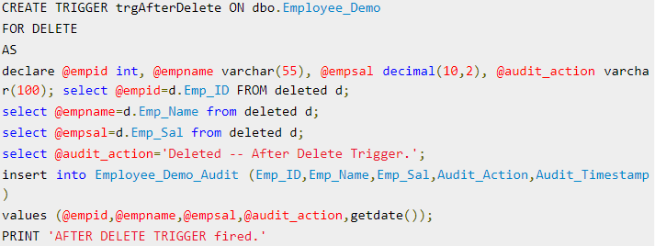

After Triggers Example for Delete
Create trigger on table Employee_Demo for Delete statement

Slide 20
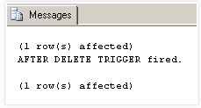
After Triggers Example for Delete
Now try to delete data in Employee_Demo table
DELETE FROM Employee_Demo where emp_id = 5
Output:

Slide 21
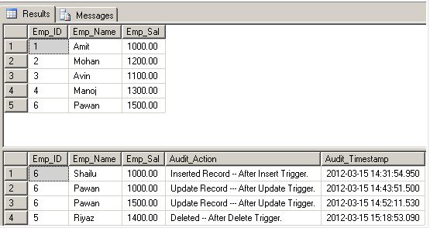
After Triggers Example for Delete
now select data from both the tables to see trigger action
select * from Employee_Demo
select * from Employee_Demo_Audit
Output:
Trigger have inserted the new record to Employee_Demo_Audit table for delete statement. In this way we can trace a delete activity on a table using trigger.

Slide 22
Instead Of Triggers
This trigger fires before SQL Server starts the execution of the action that fired it. This is much more different from the AFTER trigger, which fires after the action that caused it to fire. We can have an INSTEAD OF insert/update/delete trigger on a table that successfully executed but does not include the actual insert/update/delet to the table.
Example :If you insert record/row in a table then the trigger associated with the insert event on this table will fire before the row passes all the checks, such as primary key, rules, and constraints. If the record/row insertion fails, SQL Server will fire the Instead of Trigger.

Slide 23
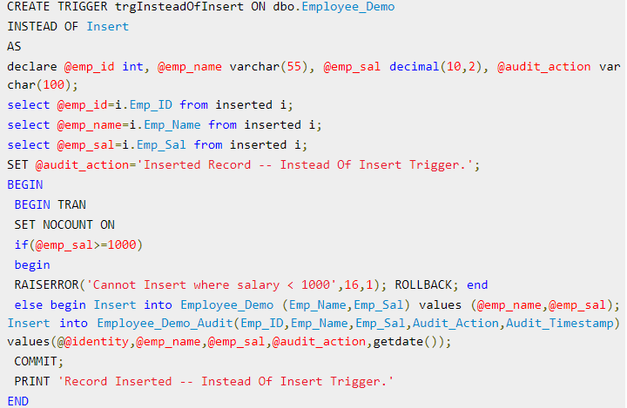
Instead of Triggers Example for Insert
Create trigger on table Employee_Demo for Insert statement

Slide 24
Instead of Triggers Example for Insert
Now try to insert data in Employee_Demo table
insert into Employee_Demo values ('Shailu',1300)
insert into Employee_Demo values ('Shailu',900) -- It will raise error since we are checking salary < 1000
Output:

Slide 25
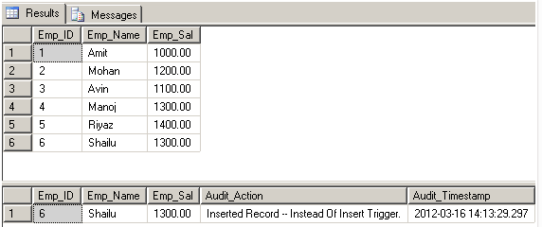
Instead of Triggers Example for Insert
now select data from both the tables to see trigger action
select * from Employee_Demo
select * from Employee_Demo_Audit
Output:
Trigger have inserted the new record to Employee_Demo_Audit table for insert statement. In this way we can apply business validation on the data to be inserted using Instead of trigger and can also trace a insert activity on a table.

Slide 26
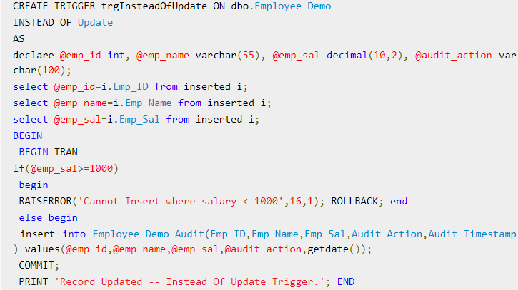
Instead of Triggers Example for Update
Create trigger on table Employee_Demo for Update statement

Slide 27
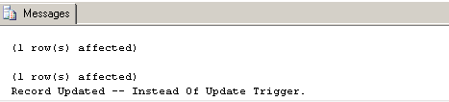
Instead of Triggers Example for Update
Now try to upadte data in Employee_Demo table
update Employee_Demo set Emp_Sal = '1400' where emp_id = 6
update Employee_Demo set Emp_Sal = '900' where emp_id = 6
Output:

Slide 28
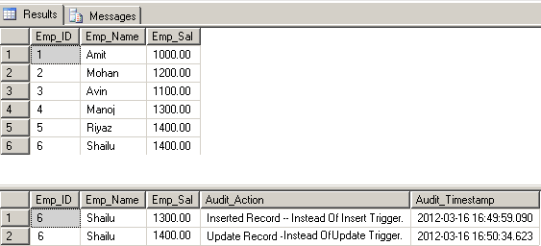
Instead of Triggers Example for Update
now select data from both the tables to see trigger action
select * from Employee_Demo
select * from Employee_Demo_Audit
Output:
Trigger have inserted the updated record to Employee_Demo_Audit table for update statement. In this way we can apply business validation on the data to be updated using Instead of trigger and can also trace a update activity on a table.

Slide 29
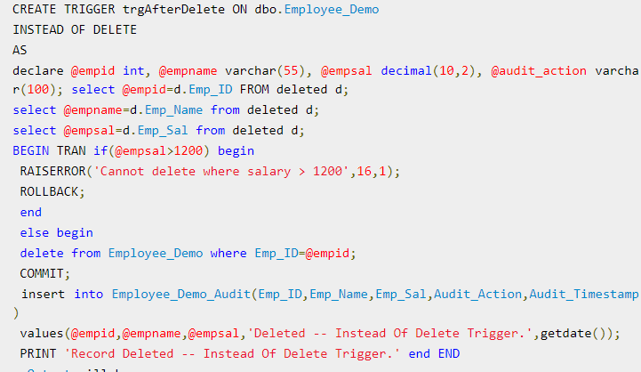
Instead of Delete Trigger Example
Create trigger on table Employee_Demo for Delete statement

Slide 30
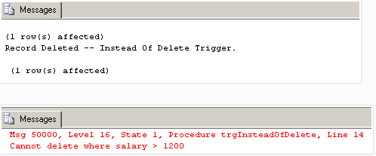
Instead of Delete Trigger Example
Now try to delete data in Employee_Demo table
DELETE FROM Employee_Demo where emp_id = 1
DELETE FROM Employee_Demo where emp_id = 3
Output:

Slide 31
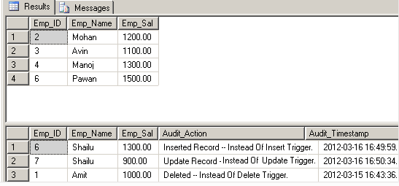
Instead of Delete Trigger Example
now select data from both the tables to see trigger action
select * from Employee_Demo
select * from Employee_Demo_Audit
Output:
Trigger have inserted the deleted record to Employee_Demo_Audit table for delete statement. In this way we can apply business validation on the data to be deleted using Instead of trigger and can also trace a delete activity on a table.

Slide 32
Uses of triggers
Complex Auditing
You can use triggers to track changes made to tables.
Enforce Business Rules
Triggers can be used to inspect all data before a DML action is performed. You can use INSTEAD OF triggers to “intercept” the pending DML operation, apply any business rules, and ultimately complete the transaction.
Derive Column Values
Triggers can be used to calculate column values. For instance, for each customer you may wish to maintain a TotalSales column on the customer record. Of course, for this to remain accurate, it would have to be update every time a sales was made.This could be done using an AFTER trigger on INSERT, UPDATE, and DELETE statements for the Sales table.

Slide 33
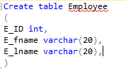
Example Exercise
Step 1 :
Create an Example Database Employee details
Step 2 :
Create table Employee with following fields:

Slide 34

Example Exercise
Step 3 :
Create table Employee_Log with following fields:

Slide 35
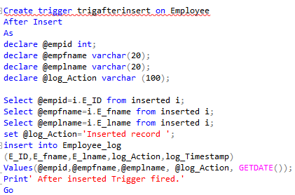
Example Exercise
Step 4 :
Create Trigger After insertion:

Slide 36
Example Exercise
Step 5 :
Insert Some Records in the Table Employee
Step 6 :
Write Select statement for Retrieving records from Table Employee_Log

Slide 37
ALL IN ONE TRIGGER
CREATE TABLE Employees
(
EmployeeID int NOT NULL IDENTITY(1, 1) ,
EmployeeName VARCHAR(50) ,
EmployeeAddress VARCHAR(50) ,
MonthSalary DECIMAL(10, 2)
PRIMARY KEY (EmployeeID)
)
GO

Slide 38
ALL IN ONE TRIGGER
CREATE TABLE EmployeesAudit
(
AuditID INT NOT NULL IDENTITY(1, 1) ,
EmployeeID INT ,
EmployeeName VARCHAR(50) ,
EmployeeAddress VARCHAR(50) ,
MonthSalary DECIMAL(10, 2) ,
ModifiedBy VARCHAR(128) ,
ModifiedDate DATETIME ,
Operation CHAR(1)
PRIMARY KEY ( AuditID )
)
GO

Slide 39
ALL IN ONE TRIGGER
INSERT INTO dbo.Employees
( EmployeeName ,
EmployeeAddress ,
MonthSalary
)
SELECT 'Mark Smith', 'Ocean Dr 1234', 10000
UNION ALL
SELECT 'Joe Wright', 'Evergreen 1234', 10000
UNION ALL
SELECT 'John Doe', 'International Dr 1234', 10000
UNION ALL
SELECT 'Peter Rodriguez', '74 Street 1234', 10000
GO

Slide 40


REMEMBER:
SELECT 0 FROM table does not return any column values of the table but rather
a constant for every row of table - e.g. if you have the following table
and the following statement
SELECT 0 FROM table WHERE age > 12
]

Slide 41
ALL IN ONE TRIGGER
ELSE
BEGIN
INSERT INTO dbo.EmployeesAudit
( EmployeeID ,
EmployeeName ,
EmployeeAddress ,
MonthSalary ,
ModifiedBy ,
ModifiedDate ,
Operation
)
SELECT D.EmployeeID ,
D.EmployeeName ,
D.EmployeeAddress ,
D.MonthSalary ,
@login_name ,
GETDATE() ,
'D'
FROM Deleted D
END
END
ELSE
BEGIN
INSERT INTO dbo.EmployeesAudit
( EmployeeID ,
EmployeeName ,
EmployeeAddress ,
MonthSalary ,
ModifiedBy ,
ModifiedDate ,
Operation
)
SELECT I.EmployeeID ,
I.EmployeeName ,
I.EmployeeAddress ,
I.MonthSalary ,
@login_name ,
GETDATE() ,
'I'
FROM Inserted I
END
GO
CREATE TRIGGER TR_Audit_Employees ON dbo.Employees
FOR INSERT, UPDATE, DELETE
AS
DECLARE @login_name VARCHAR(128)
SELECT @login_name = login_name
FROM sys.dm_exec_sessions
WHERE session_id = @@SPID
IF EXISTS ( SELECT 0 FROM Deleted )
BEGIN
IF EXISTS ( SELECT 0 FROM Inserted )
BEGIN
INSERT INTO dbo.EmployeesAudit
( EmployeeID ,
EmployeeName ,
EmployeeAddress ,
MonthSalary ,
ModifiedBy ,
ModifiedDate ,
Operation
)
SELECT D.EmployeeID ,
D.EmployeeName ,
D.EmployeeAddress ,
D.MonthSalary ,
@login_name ,
GETDATE() ,
'U'
FROM Deleted D
END

Slide 42
TRY TRIGGER
BEGIN TRANSACTION
SELECT *
FROM dbo.Employees
WHERE EmployeeID = 1
UPDATE Employees
SET EmployeeName = 'zzz'
WHERE EmployeeID = 1
SELECT *
FROM dbo.Employees
WHERE EmployeeID = 1
SELECT *
FROM dbo.EmployeesAudit
ROLLBACK TRANSACTION

Slide 43
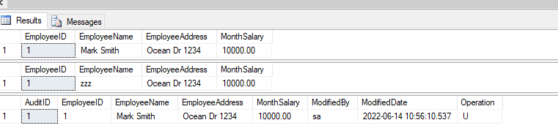
FINAL OUTPUT

Slide 44
tasks
Create
After Insert
After Update
After Delete
Triggers on Shippers Table in Northwind Database. Record query and their respective results in output.
2) Create
Instead of Insert
Instead of Update
Instead of Delete
Triggers on Orders Table in Northwind Database. Record query and their respective results in output.

